Slide 1

Hucknall National CE Primary School
E-Safety Evening
Monday 20th March 2017

Slide 2
Outline of the Evening
What is e-safety and what are our school procedures
What do we teach the children about e-safety
Practical advice for keeping your children safe at home
Where to go for help
Questions and Answers

Slide 3
What is e-safety?
It is about how to use the technology safely and responsibly including the Internet and Mobile Phones
It highlights the need to educate pupils about the benefits and risks of using technology and provides safeguards and awareness for users to enable them to control their online experience.

Slide 4
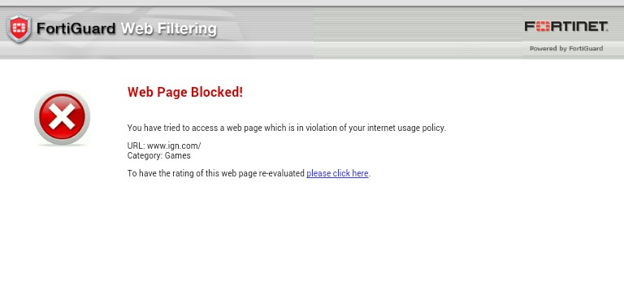
What do we do to ensure children are safe when using the Internet in school?
Web filtering (Fortiguard)
Children not using devices unsupervised
Clear reporting procedure if something is something inappropriate happens to be seen.

Slide 5


What we teach in school…
Children will be taught what Internet use is acceptable and what is not and given clear objectives for Internet use. This includes awareness of on line bullying and child sexual exploitation.
Pupils will be educated in the effective use of the Internet in research, including the skills of knowledge location, retrieval and evaluation
Share Aware – Lucy and The Boy
https://youtu.be/T9LHeHuVFWo
Share Aware – I Saw Your Willy
https://youtu.be/iofMV1HVQOY
Jigsaw
https://www.youtube.com/watch?v=_o8auwnJtqE

Slide 6
Practical advice for keeping your children safe at home
Make it your business to know what the children have been on. Create a culture of openness by keeping device use visible and not hidden away.
Learn how to use Restricted Profile and Parental Controls on tablet/phone devices
Learn how to activate filtering from your ISP (BT, Sky, TalkTalk and Virgin Media all have their own filtering) https://www.saferinternet.org.uk/advice-centre/parents-and-carers/parental-controls-offered-your-home-internet-provider
Try to keep up with apps that the children are wanting to use.

Slide 7
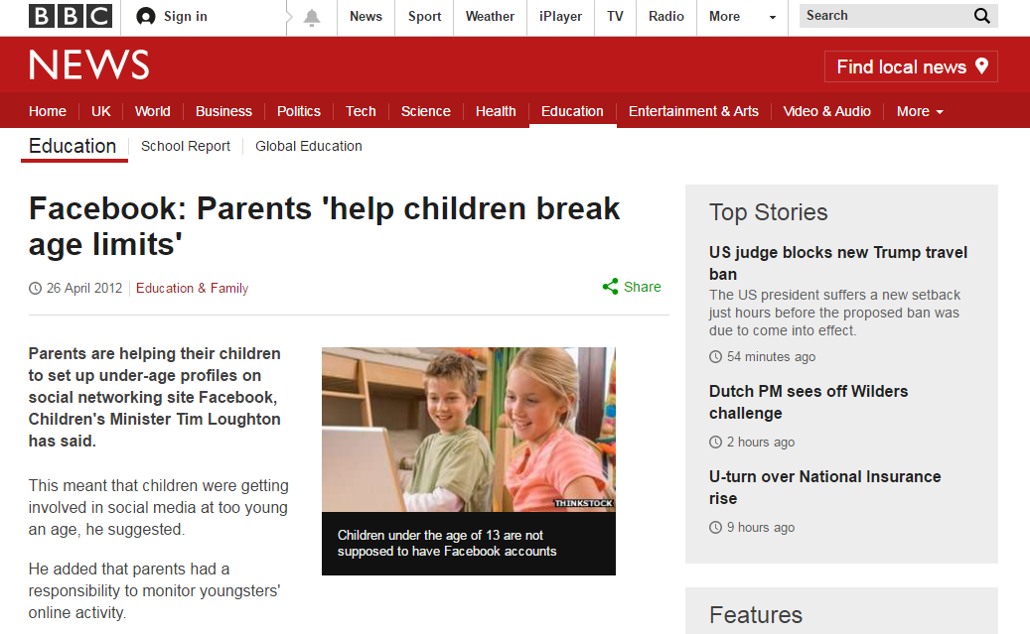
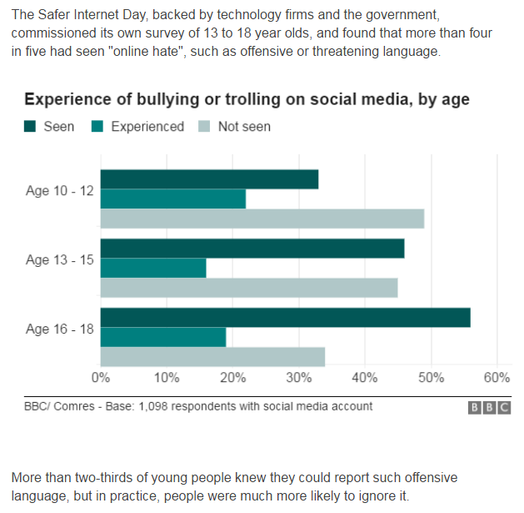


Slide 8
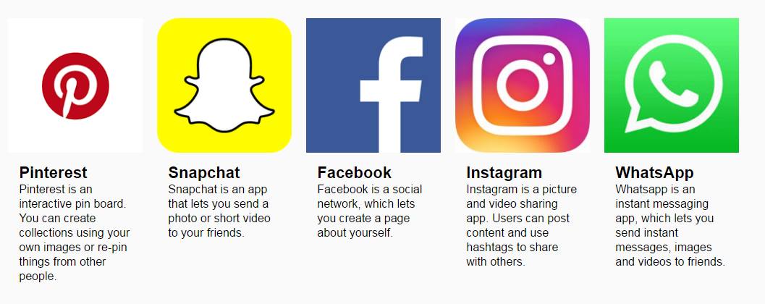
Monitoring social media…
Age Restrictions
Youtube: 13 years old with parents’ permission, 18 years old otherwise
Facebook, Twitter, Instagram, Pinterest, Snapchat: 13 years old
WhatsApp: 16 years old.

Slide 9
Find out more…
www.saferinternet.org.uk
www.nspcc.org.uk/children-safe/share-aware
www.thinkuknow.co.uk
www.childnet.com
Any questions?

Slide 10

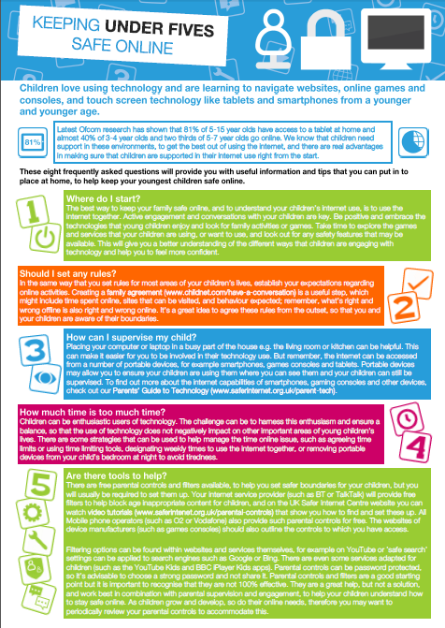

Slide 11


