Slide 1
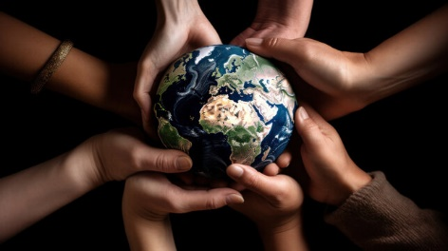
How to look after the Earth!
By the National Eco Team

Slide 2
The National Eco Team – Who we are
Amy | Anais
Phoebe D | Lara
Evie | Jackson
Phoebe O | Ruby
Micah | Lacey
Rosina | Amelia

Slide 3
Why are we doing this assembly?
We are doing this assembly because we are the environmental team (Eco Team) and we are here to tell you fun facts and information about the environment and how you can save it.
We are Courageous Advocates because we are agents of change. We stand up for God’s beautiful world.

Slide 4
The National Eco Team Promise
Thankfulness – we are thankful for God’s creation across the world.
Respect – we respect our school environment and all of God’s Earth.
Forgiveness – we forgive people for not always making good choices about our planet.
Trust – we trust that people working together can make a change.
Hope – we hope for a better and brighter future for planet Earth.
Love – we want to share love with everyone for our beautiful world.

Slide 5
The National Eco Team Promise
We promise to look after our school environment and all of God’s creation.
We promise to educate people to treat Earth with respect.
We promise to do everything we can to make a positive change.

Slide 6
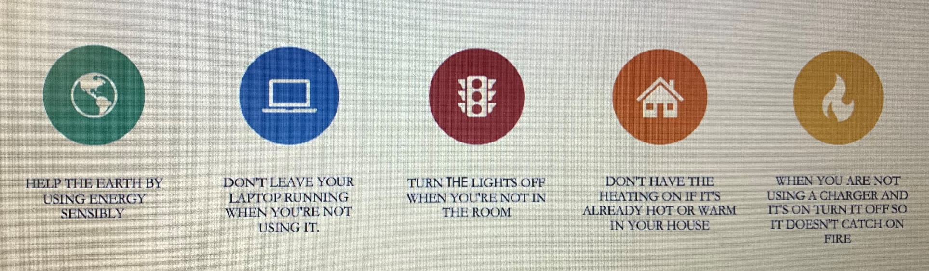

Slide 7
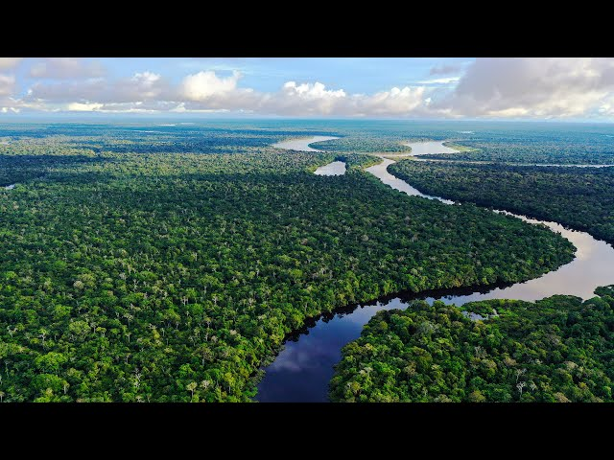
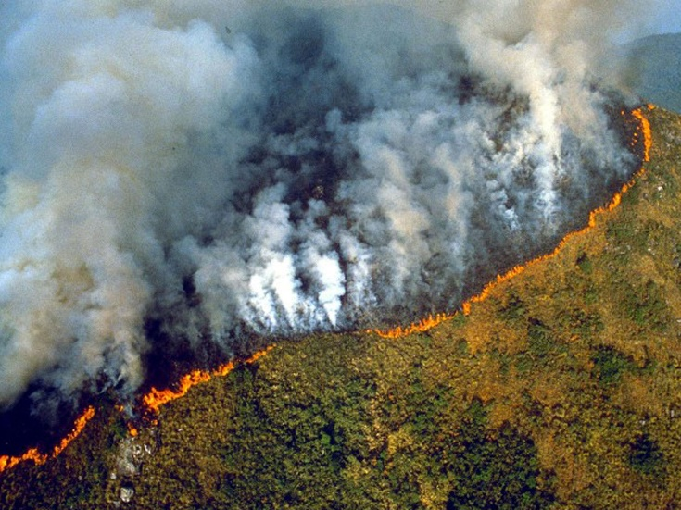
Reduce, reuse, recycle
Cut down on what you throw away
Bike more, drive less
Stop wasting money on plastic if you’re just going to throw it away.

Slide 8
Some ways to save the environment
Use long lasting light bulbs
Trees provide food and oxygen
Trees help clean the air and help combat climate change
Don’t drop litter
The more water you use, the more water you waste
Don’t put plastic in the ocean

Slide 9
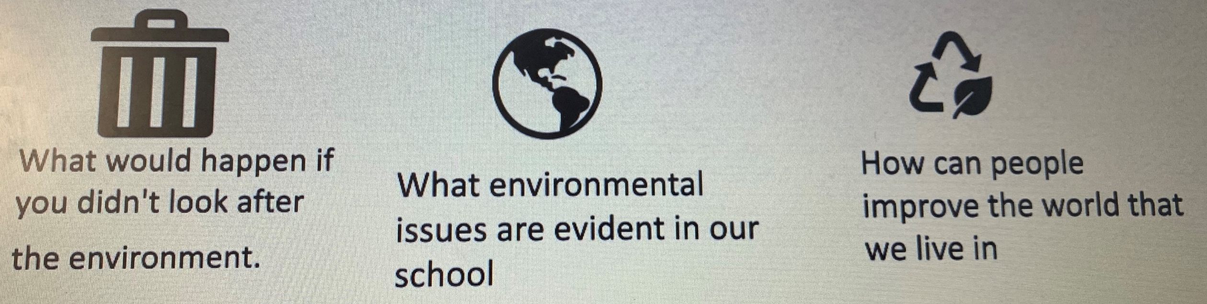

Slide 10

Never leave your car engines on when you are parked somewhere and when it is unnecessary.
Instead of putting your car heater on and running the car engine, just put on a warm jumper!

Slide 11
We have a problem with litter at our school!
More than 2 million pieces of litter are dropped in the sea.
Almost 48% of people admit to dropping litter.
7 out of 10 items of litter are food packaging or food wrappers.
One third of motorists admit to throwing rubbish out of their windows when they are driving.
Orange peel and banana peel take 2 years to biodegrade but foil never biodegrades.

Slide 12
National Eco Team Prayer
God of life,
We praise you for the beauty of creation,
Its richness and variety.
Make us more like Jesus,
Treading gently on our common home,
And breath your Spirit on us,
That we may care more deeply for your Earth.
We ask this through Jesus Christ our Lord.
Amen.

