Slide 1
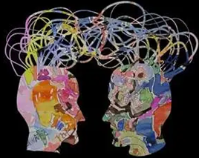
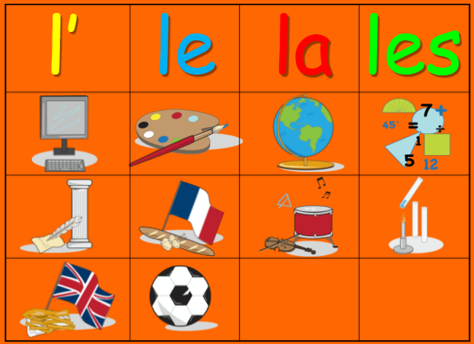

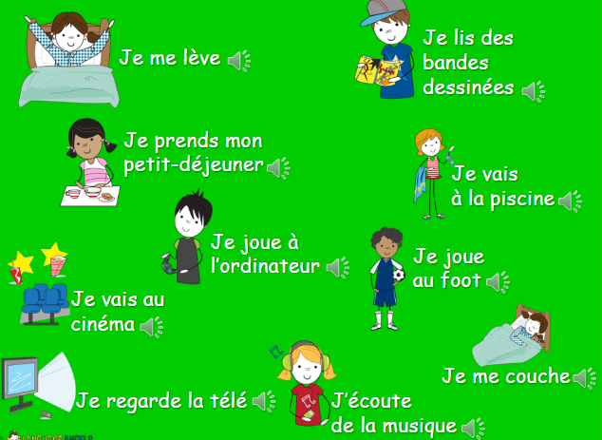
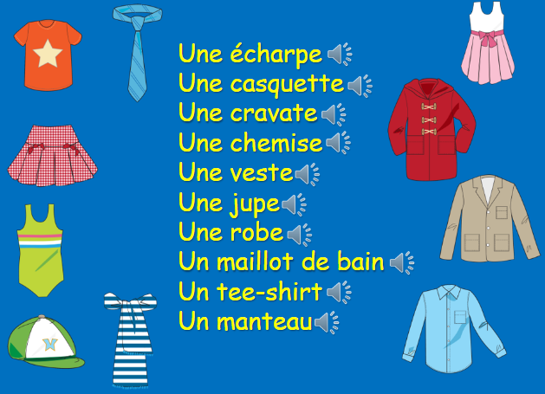
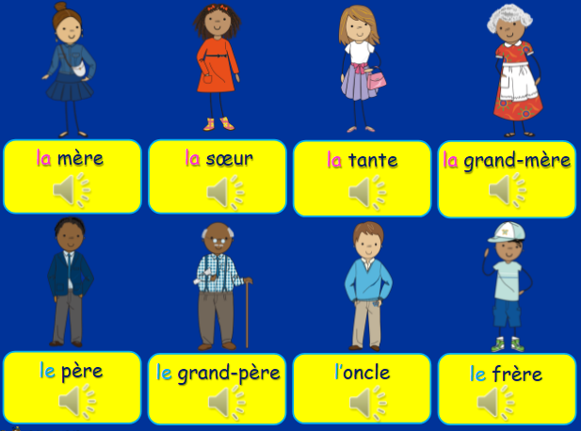
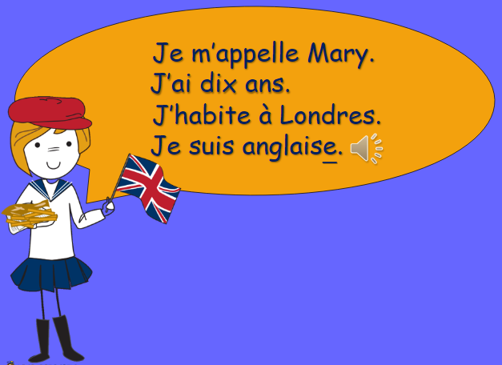
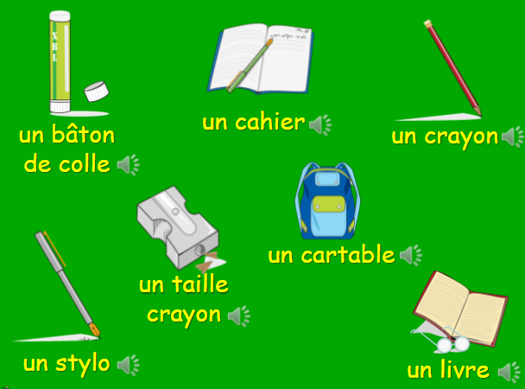
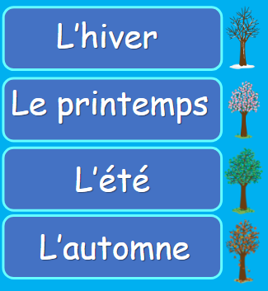
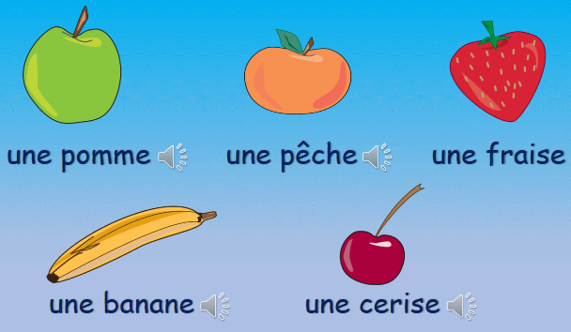
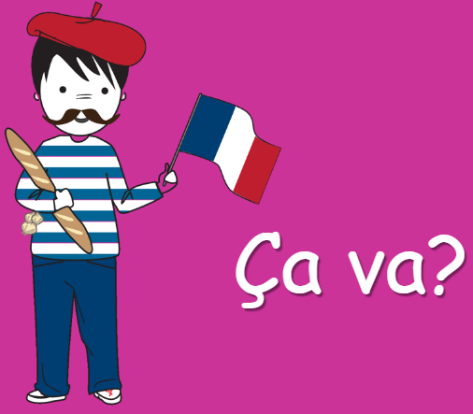
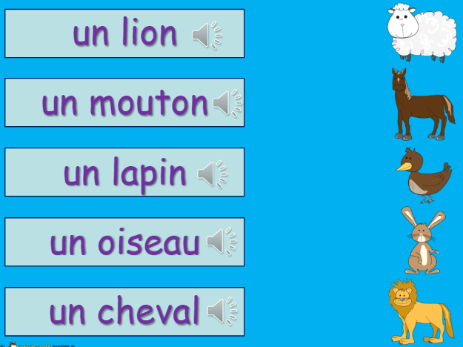
Why do we teach French?
It is the fourth most spoken language across the world (280 million speakers). It is recognised as the official language in 29 countries which makes it useful for people who want to travel.
Children gain a good understanding of the structure of other languages through French; it has many similarities to Spanish, Italian and Portuguese.
We chose to teach the children French as this supports their transition into our local high schools that also teach French.
Learning another language develops children’s cultural awareness and understanding of the world around them.
It extends their knowledge of how language works and helps them to develop communication skills.
Language learning also provides frequent opportunities to perform before an audience. This nurtures pupils' self-esteem and self- confidence and develops strong interpersonal skills.
“With languages, you are at home anywhere.” Roger Bacon4hes
Key Concepts
“With languages, you are at home anywhere”.
Roger Bacon
Communication
Expression of ideas and thoughts using language and to understand and respond to other speakers
Disciplinary Knowledge
LE WEEK-END
Tell the time in French using quarter past, half past and quarter to.
Say and write in French what we do at the weekend using two or more sentences.
Integrate conjunctions and opinions into written and spoken work to make more interesting and extended sentences
Culture
The ideas, customs, and social behaviour of particular people or society
A L’ECOLE
Name the subjects we study in school in French with the correct definite
article/determiner.
Extend sentences by giving an opinion on the various school subjects and
extend even further by giving a justification for that subject.
Start to tell the time by learning how to say time by the hour.
Say at what time we study certain subjects at school.
Key Concepts
Composition
KS2 Key Concepts
Y6 LISTEN, USE, READ, WRITE |  |  | Y6 CULTURE
Y6 ORACY | Y6 VOCAB | Y6 SPAG
Where do you go to school? I go to … My favourite subject is… I like… I don’t like … because … What time is it? It is …o’clock What do you do at the weekend? I like to … and… because… | Key vocabulary on 10 nouns and definite articles for school subjects with positive and negative opinions in reply to the target question est-ce que tu aimes…? and a variety of justifications to expand the opinion given in reply. Ten phrases on activities to do at the weekend. A range of conjunctions and opinions to be able to fully answer the question qu’est-ce que tu fais le week-end? | Pronunciation: Silent letters Guttural ‘R’ Elision. Liason Nasal sounds Grammar: Nouns, gender, definite articles & high frequency regular verb étudier. Verbs, conjunctions and opinions. | French residential Visit monuments, experience food, shopping
Communication
Listen attentively and understand phrases and sentences in a foreign language.
Use simple conjunctions to build more complex sentences when speaking and present information to others in a foreign language.
Read a variety of short simple texts in different formats and in different contexts in a foreign language. Focus on correct pronunciation and intonation, using tone of voice and gesture to convey meaning when reading aloud.
Write short texts in a foreign language and use a dictionary to check the spelling of words.
YEAR
Comprehension
6
Communication
LES VETEMENTS
Recognise and recall from memory 21 items of clothing.
Explore the regular ‘er’ whole verb present tense conjugation of the verb PORTER to describe what you and possibly somebody else is wearing.
Revisit the use of the possessive adjective ‘my’ in French and describe clothes in terms of colour.
KS2 Key Concepts
LA FAMILLE
Remember the nouns for family members in French from memory.
Describe our own or a fictitious family in French by name, age, and
relationship.
Count to 70 in French.
Understand possessive adjectives better in French (‘my’ form only).
Composition
Y5 LISTEN, USE, READ, WRITE |  |  | Y5 CULTURE
Y5 ORACY | Y5 VOCAB | Y5 SPAG
What do you have in your pencil case? I have … I do not have … What is your name? My name is … How old are you? I am … years old Where do you live? I live in … What is her/his name? They are called … In my family … | 11 nouns and articles for common classroom objects, 10 simple classroom commands. J’ai… (‘I have’) will be revisited before introducing the negative reply je n’ai pas de/d’…(I don’t have) We will revisit basic personal details (name/age/where you live/nationality) and learn the nouns and articles/determiners for family members, he/she is called and numbers 1-70, plus how to say how old we are. Revisiting colours and the vocabulary to describe weather. Learn the 21 items of clothing and the full conjugation for the regular ‘er’ verb porter to wear. | Pronunciation: Silent letters Guttural ‘R’ Elision. Liason Nasal sounds Grammar: Nouns, gender, articles/determiners & use of the negative. Possessive adjectives. Verbs, definite, indefinite, partitive articles & adjectival agreement. | Schooling in France – links to French Primary School (email exchange and Zoom). French customs and culture. Shopping in France Traditional dances/ clothing.
YEAR
5
Comprehension
Communication
EN CLASSE
Recall from memory a selection of nouns and indefinite articles for
common classroom objects.
Learn how to use the negative in French.
Describe what we have and do not have in our pencil case.
Respond to simple classroom commands.
Culture
Explore cultural stereotypes and justify why they are flawed and inaccurate.
KS1 Key Concepts
Y4 LISTEN, USE, READ, WRITE |  |  | Y4 CULTURE
Y4 ORACY | Y4 VOCAB | Y4 SPAG
It is … My favourite season is… because … How are you feeling? I am feeling … I am … What is your name? My name is … How old are you? I am … years old Where do you live? I live in … | The nouns and determiners/articles for the four seasons in French. Including the language required to say which is our favourite season and why, using the connectives ‘et’ (and) and ‘car’ (because). Numbers 1-10 will be revisited along with the language to express how you are feeling. Plus new language to ask and answer the questions related to basic personal details (name, age, where you live and nationality) | Pronunciation: Silent letters Guttural ‘R’ Elision. Liason Nasal sounds Grammar: Nouns & articles/determiners. Adjectival agreement. | Well known French people (artists and sports). Different places to live in France – including different types of houses. Schooling in France – links to French Primary School (email exchange and Zoom).
JE ME PRESENTE
Know how count to 20 in French.
Ask somebody how they are feeling and give an appropriate response
back.
Ask somebody their age, name, where they live and reply.
Composition
Comprehension
YEAR
4
LES SAICONS
Name, recognise and remember all four seasons in French.
Say which is our favourite season in French.
Say why it is our favourite season in French.
Start to recognise and use the conjunctions ‘et’ (and) & ‘car’ (because) in our spoken and written responses
Communication
LES FRUITS
Name, recognise and remember up to 10 fruits in French.
Attempt to spell some of these nouns with their correct article/determiner.
Ask somebody in French if they like a particular fruit.
Say what fruits we like and dislike in French.
Y3 LISTEN, USE, READ, WRITE |  |  | Y3 CULTURE
Y3 ORACY | Y3 VOCAB | Y3 SPAG
What do you call yourself? I call myself… • How are you? Well/bad/good/awful thanks… etc • How old are you? I am… years old • What colour is? I have … eyes. • How many... are there? I am a … It is a … I like/ I do not like | Language to ask how somebody is feeling and give a reply. Ten key colours and numbers 1-10. 10 common animals. The animals plus their appropriate indefinite article. First person conjugation of the verb être (je suis = I am). The nouns and determiners/articles for 10 common fruits in French. The language required to ask a question in French and how to answer the question in French (using the positive and negative form). | Pronunciaton: Silent letters Guttural ‘R’ Elision. Liason Nasal sounds Grammar: Nouns, gender, articles/determiners and plural form. | There will be a number of different activities to improve our cultural awareness of France and French speaking countries. Christmas in France. Foods popular in France.
EYFS Key Concepts
Composition
Comprehension
LES ANIMAUX
Name and recognise up to 10 animals in French.
Attempt to spell some of these nouns with their correct indefinite article.
Pretend that we are a particular animal using the 1st person singular of the verb être (je suis = I am)
J’APPRENDS LE FRANÇAIS
To locate France, Paris and a few key cities on a map.
Say our name and how we are feeling.
Learn up to 10 colours and count from 1-10 in French.
YEAR
3
Communication
MFL - French
“If you talk to a man in a language he understands, it goes to his head. If you talk to a man in his language that goes to his heart” Nelson Mandela

